Slide 1
School Readiness and Social-Emotional Development:
National Black Child Development Institute
Notes:
Workshop Housekeeping

Slide 2
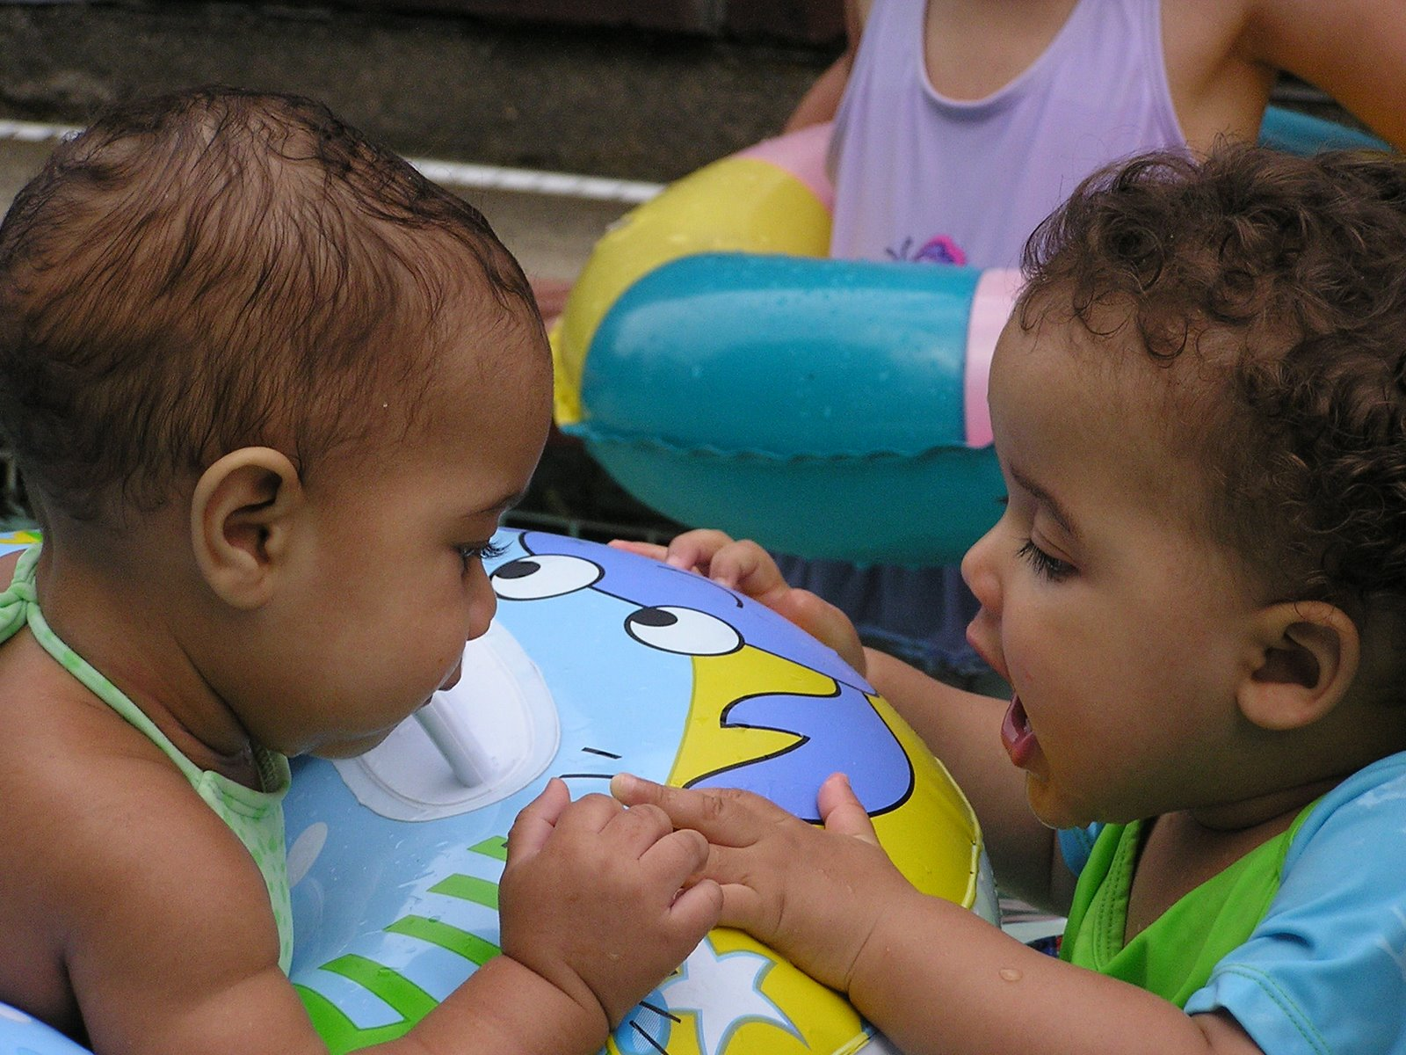
Introductions
Notes:
Introductions/Agenda/Rules

Slide 3
Mission:
NBCDI's mission is to improve and advance the lives of Black children and their families through advocacy and education.
Vision:
NBCDI's vision is a society that embraces the commitment to a successful future for every child.

Slide 4
Understanding Relationships
Reflect on a person who was a positive influence in your childhood.
Think about the relationship.
How did that person make you feel?
What specific things attributed to this feeling?
Article

Slide 5
School Readiness
School readiness is multidimensional
It includes five domains:
Physical well-being and motor development
Social and emotional development
Language development
Approaches to learning
Cognition and general knowledge
(School Readiness and Social-Emotional Development: Perspectives on Cultural Diversity, Brunson Day, p. 24)

Slide 6
EC educators support social and emotional development and to provide positive guidance
EC educators provides physical and emotional security for each child and helps each child to know, accept and take pride in him or herself and to develop a sense of independence.
Notes:
Section 2

Slide 7
Workshop Objectives
Early Social-emotional development is influenced by many factors including culture.
Our beliefs and value systems (our family, our culture) influence our responses to interactions and relationships with others.
Supportive relationships between a teacher and child promote the social-emotional skills children need to attend to learning/school readiness.
Respect, honesty and understanding are important factors in promoting a child’s development.

Slide 8
“Every child has a right to a role model whose task it is to open the door and show the way”
- NBCDI,
Vision for African American Children
Notes:
Section 3

Slide 9
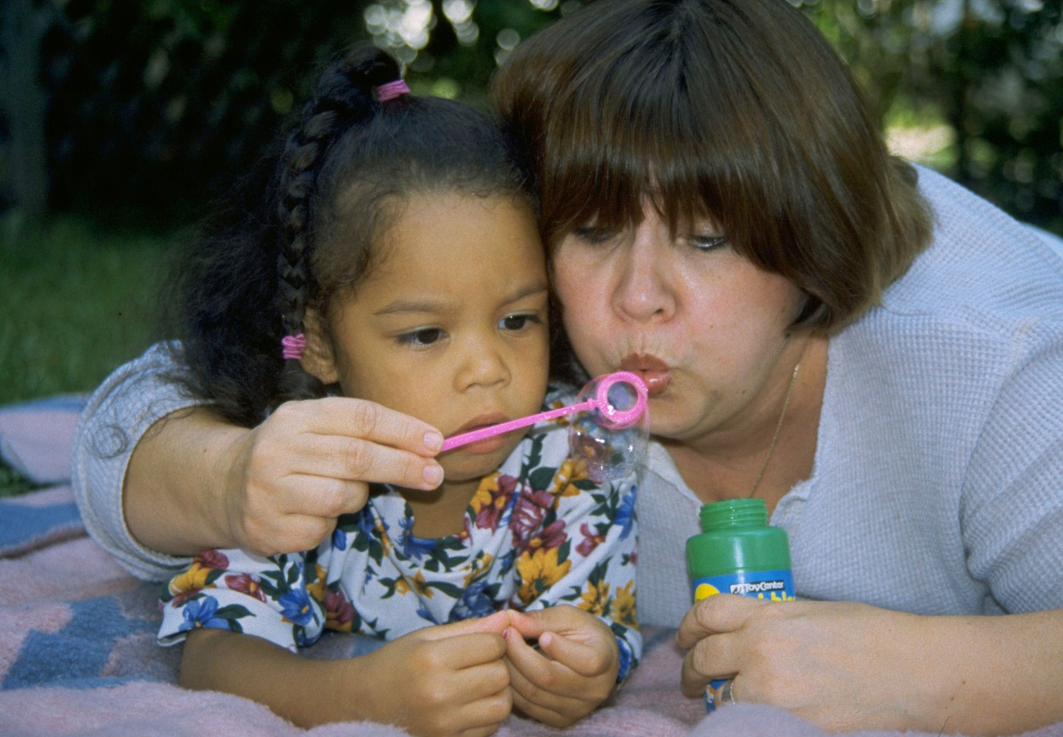
Activity:
Understanding Relationships
Notes:
T-Shirt Poem

Slide 10
T-Shirt” from My Name is Jorge: On Both Sides of the River
by J. Medina
Teacher?
George, please call me “Mrs. Roberts.”
Yes, Teacher.
George, please don’t call me “teacher.”
Yes, T-, I mean, Mrs. Roberts.
You see, George, it’s a sign of respect to call me by my last name.
Yes,… Mrs. Roberts.
Besides, when you say it, it sounds like “t-shirt,” I don’t want to turn into a t-shirt!”
Mrs. Roberts?
Yes George?
Please, call me Jorge.

Slide 11
Activity:
Understanding Relationships
How would you describe the relationship between Jorge and his teacher?
What message(s) may Jorge have received from the interaction with his teacher?
What message(s) may the teacher have received from the interaction with Jorge
Think about your own experiences?

Slide 12
What is culture?
Notes:
Enter Chat-rooms

Slide 13
A Deeper Look at Culture
Culture is embodied by rules that shape behavior
Culture is learned
Individual members are embedded to different degrees within their cultural group
Culture is dynamic

Slide 14
EC educators help support social and emotional development and to provide positive guidance
EC educators helps each child feel accepted in the group, helps children learn to communicate and get along with others and encourages feelings if empathy and mutual respect among children and adults.
Notes:
Section 2

Slide 15
To understand that culture is dynamic
Our beliefs and value systems
Supportive relationships between a teacher and child To establish a working definition of culture.
The way we view others culturally is not always consistent with the way others may want to be viewed themselves.
As Early Childhood Educators need to advance our knowledge of culture

Slide 16
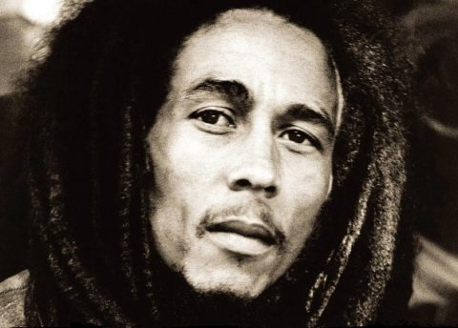

Slide 17
Distinction Between Culture, Race and Ethnicity
Culture is sociological
Passed down through generations
Constitutes rules for behavior & relationships
Race is biological
Represents our physical dimension
Politically defined
Ethnicity is geographical
Represents the placement of where we have come
(Day, C., 2007)
Notes:
Section 3

Slide 18
“Culture is the lens through which children learn the rules of relationships that enable them to develop.”
- Day, C., p. 25

Slide 19
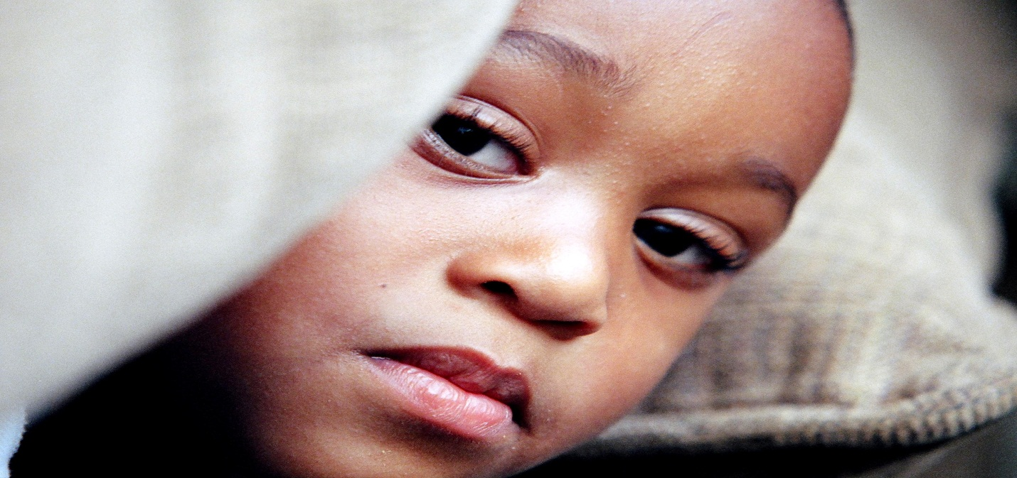
Building Cultural Competence
Develop deeper understanding of
culture.

Slide 20
Getting to Know You
List 5 things that describe yourself on a sheet of paper that would help someone get to know you better.

Slide 21
3 Levels of Culture
Concrete – Most visible and tangible level that includes most surface-level dimensions such as appearances, clothes, food, music, games and others.
Behavioral – Clarifies how we define social roles, the language we speak, and our approaches to nonverbal communication. Includes: language, gender roles, family dynamics and structure, political affiliation, and other that situation us organizationally in society.
Symbolic – Includes our values and beliefs. Often the basis of how individuals define themselves. Includes our value systems, customs, spirituality, religion, worldview, beliefs, mores, and others.
Hildalgo, N. 1993

Slide 22
Food For Thought
When you meet somebody, which of the items under any of the dimensions do you use to understand them culturally?
Is your attempt to understand others culturally consistent with how you want to be viewed and understood?
What forces in our society might contribute to our simplification of the culture of others, even though we don’t want to be defined simplistically ourselves?
When you teach, what dimensions do you use to teach multiculturally?

Slide 23
Another Look at Culture
Culture is embodied by rules that shape behavior
Culture is learned
Individual members are embedded to different degrees within their cultural group
Culture is dynamic
(Day,C. p.29)

Slide 24
Advancing Knowledge of Cultural Groups
Seek out authentic sources of information about various cultural groups
Develop tentative hypotheses about behavior and understand how to verify information
Make the distinction between stereotypes and genuine cultural characteristics of groups and know how to use and weigh information appropriately
Understand who we are culturally and have a healthy sense of what we do not know

Slide 25
Building Cultural Competence
Develop deeper understanding of culture.
Understand the effects of racial & cultural bias that contribute to a child’s underdevelopment.
Advance our knowledge and understanding of cultural groups.
Embrace the value of a culturally diverse workforce.

Slide 26
To establish positive and productive
relationships with families
EC educators maintains an open friendly and cooperative relationship with each child’s family, encourages their involvement in the program and support the child’s relationship with his/her family.
Notes:
Section 2

Slide 27
Cultural Competence
Recognizing institutional bias
How classroom materials can represent values and influence beliefs
Make the connection to the interdependence of early social development and academic learning
Understand how EC educators are able to offer family’s insights that can help them learn strategies

Slide 28
Bias in Classroom Materials
Invisibility
Stereotyping
Selectivity & Imbalance
Unreality
Fragmentation & Isolation
Language Bias
Notes:
Section 3
From Love to Read page 11

Slide 29
Bias in Classroom Materials
Invisibility – the underrepresentation of certain microcultures where omission implies less value/significance in society
Stereotyping – the assigning of traditional roles or attributes to a group

Slide 30
Bias in Classroom Materials
Selectivity & Imbalance – issues/situations interpreted from one perspective, usually from the dominating group; contributions of cultural groups to the development of society are not recognized/taught.
Unreality – Unrealistic portrayal of history and contemporary life experience. Avoidance of issues of sexism, crime, divorce, and poverty…. everyone is “middle class”. Native Americans seen/portrayed in historical context only. African and Latino Americans only portrayed in urban or low SES setting

Slide 31
Bias in Classroom Materials
Fragmentation & Isolation - Addressing non-dominant groups in a fragmented or isolated manner, a chapter, or section rather than in an integral part of text.
Language Bias – Omission of such things as gender or ethnic group references (i.e. use of masculine pronouns or Anglo names

Slide 32
Class room resources Should
Reflect diversity of gender roles, racial and cultural backgrounds, special needs and abilities, social economic status (SES), varying occupations and ages.
Present accurate images and information
Show people from all groups living their daily lives
Depict a variety of children and families within a group
Depict various family lifestyles and incomes
Reflect different languages

Slide 33
Grab a book any book and see if you find
any institutional biases. If so, which
ones?
Let’s Discuss
Share tool

Slide 34
Advancing Knowledge of Cultural Groups
Seek out authentic sources
Develop tentative hypotheses about behavior and understand how to verify information
Make the distinction between stereotypes and genuine cultural characteristics
Understand who we are culturally

Slide 35
Teacher-Child Relationship
Provides nurturing relationships that promote social-emotional capacity
Requires a Transformation of Self
Personal biases & fears
Understand children as individuals
Know own learning styles & limitations
Creates the “goodness of fit”
Draws on what a child brings to the learning experience
Minimizes cultural discontinuity
Promotes parent partnerships

Slide 36
Promoting Parent Partnerships
By connecting with families, EC educators are able to offer families insights and can help them learn strategies for negotiating differences (cultural discontinuity) between the values and beliefs of their ethnic community and those of mainstream culture.

Slide 37
Promoting Parent Partnerships
The importance of family and neighborhood to children’s outcomes, successful school programs and their instructional practices are more likely to be effective if they reflect knowledge of the realities children face in their lives outside of the school
Intensity of involvement, both with the school and the education of their children generally, will be strongly determines by a number of different factors:

Slide 38
Factors
their culturally based socialization goals and values
expectations for their children’s behavior
their understanding of the developmental needs of children
their evaluations of their own contribution of their children learning relative to the schools contribution
their understanding of who is responsible for and who has control over children’s learning

Slide 39
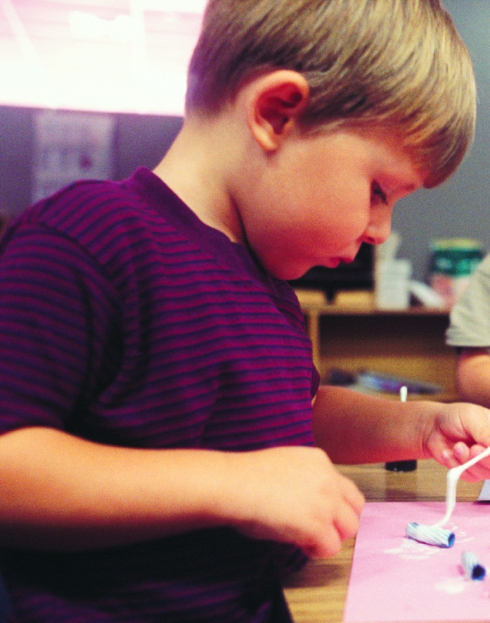
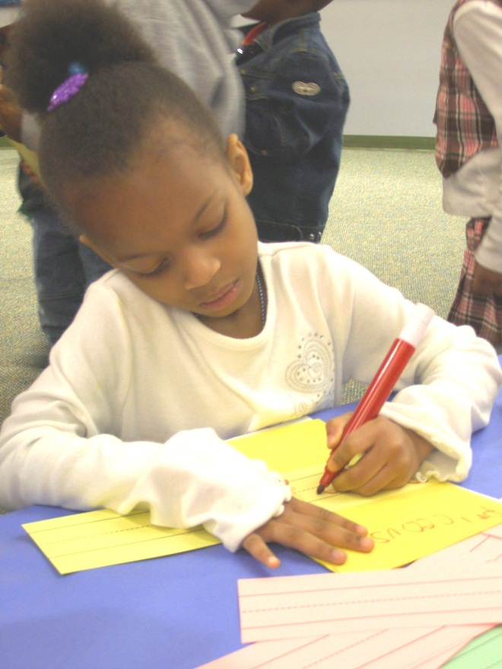
Developing Culturally Responsive Curricula & Pedagogy

Slide 40
“Culturally relevant teachers identify and build on children’s strengths and interests and adapt assessment and teaching practices to the cognitive styles and language needs of the class”
- McIntyre, 1996

Slide 41
“Goodness of Fit”
Recognizes the diversity of culture, language backgrounds and prior knowledge
Utilizes culture as a vehicle for learning
ECE serves as mediator to minimize cultural and discontinuity

Slide 42
Cultural and Linguistic Identity Displacement
“Erasing a child’s language or cultural patterns of language use is a great loss for the child. Children’s identities and senses of self are inextricably linked to the language they speak and the culture to which they have been socialized … All of the affectionate talk and interpersonal communications of their childhoods and family life are embedded in their languages and cultures.”
- Espinosa, p. 42

Slide 43
Culturally Relevant Curricula & Pedagogy
Recognizes children as individuals
Members of a cultural group
Incorporates knowledge of culture into classroom programs and instruction.
Fosters cultural continuity
Validates home culture and language
Draws on children’s experiences and background knowledge
Celebrates contributions of ethnic/cultural groups
Promotes self-esteem and self-efficacy
Creates common understanding for all children

Slide 44
Instructional Strategies and Approaches
Get to know the culture of the child and family
Provide meaning-based and balanced literacy programs
Draw on children’s experiences and background knowledge
Provide literacy experiences beyond the classroom
Build on language capacities
Role of home language on second language acquisition
Extend language abilities of school personnel

Slide 45
Instructional Strategies
Utilize culturally & linguistically diverse resources in classroom activities and curriculum instruction
Picture books that portray positive multiracial, multiethnic & physically challenged individuals as well as diverse SES environments
Poetry and song
Visuals
Engage parents
Enlist community resources
Celebrate contributions of heritage!

Slide 46
Workshop Objectives
Early Social-emotional development is influenced by many factors including culture.
Our beliefs and value systems (our family, our culture) influence our responses to interactions and relationships with others.
Supportive relationships between a teacher and child promote the social-emotional skills children need to attend to learning/school readiness.
Respect, honesty and understanding are important factors in promoting a child’s development.

